Slide 1

Wireless Networking
Ambuj Varshney
Assistant Professor, National University of Singapore
Wireless, Embedded Intelligence, Sensing, and Emerging Technologies Group
ambujv@nus.edu.sg

Slide 2
Lecture 4: Power Management, Backscatter Communication

Slide 3
Administration and Course Logistics

Slide 4
Assignment 1
Link: https://weiserlab.github.io/ambuj/cs4222_assignment1
Deadline: 10th of February 2023
Covers: 3% of overall grade
Task: Program SensorTag, display your name, blink onboard LED
Show to teaching assistant/instructor during next week’s tutorial
Issue: Some students are having issue on Mac OS X!
Notes:
++ We may all have heard of the term Internet of Things. So how are these wireless embedded systems related to the Internet of Things: Today, IoT includes a broad class of devices, including powerful platforms such as smartphones. However, it also includes more resource-constrained devices and what we call Wireless Embedded Systems, and in fact, I consider it to be one of the essential parts of the IoT ecosystem.
++ These are platforms equipped with a radio transceiver, sensor, microcontroller, and some form of energy storage. These platforms also often form a network, and sensor network as it is called has been an active area of research for the past two decades.
++ The research community has also developed wireless embedded platforms which we may know about, and these include: CMUCAM, which is an image sensor platform developed at Carnegie Mellon University, or Permamote is long life sensor platform from the lab I am associated with at UC Berkeley or Lorea which is a long-range backscatter platform that I had developed as part of my doctoral dissertation at Uppsala University. All of these are an example of Wireless Embedded Systems.

Slide 5
Assignment 1
Not working? Missed Session? Other Issues?
Tutorial #4: Released tomorrow
Assignment #2: Released tomorrow
Any other points for discussion?
Notes:
++ We may all have heard of the term Internet of Things. So how are these wireless embedded systems related to the Internet of Things: Today, IoT includes a broad class of devices, including powerful platforms such as smartphones. However, it also includes more resource-constrained devices and what we call Wireless Embedded Systems, and in fact, I consider it to be one of the essential parts of the IoT ecosystem.
++ These are platforms equipped with a radio transceiver, sensor, microcontroller, and some form of energy storage. These platforms also often form a network, and sensor network as it is called has been an active area of research for the past two decades.
++ The research community has also developed wireless embedded platforms which we may know about, and these include: CMUCAM, which is an image sensor platform developed at Carnegie Mellon University, or Permamote is long life sensor platform from the lab I am associated with at UC Berkeley or Lorea which is a long-range backscatter platform that I had developed as part of my doctoral dissertation at Uppsala University. All of these are an example of Wireless Embedded Systems.

Slide 6
Learning Objective for Today’s Lecture
Review: last few lecture’s topics
Battery-life, lifespan consumption calculation
Power consumption for wireless networking
Case study: Mobile phones
Example: IoT platform (sensor mote)
Low-Power Wireless Transmission using Backscatter Communication
Long-range backscatter communication
Battery-free devices and rest

Slide 7
Review (last lectures)

Slide 8
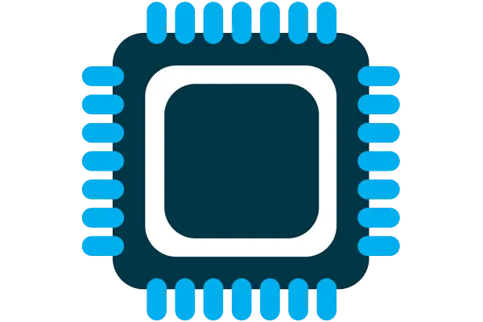
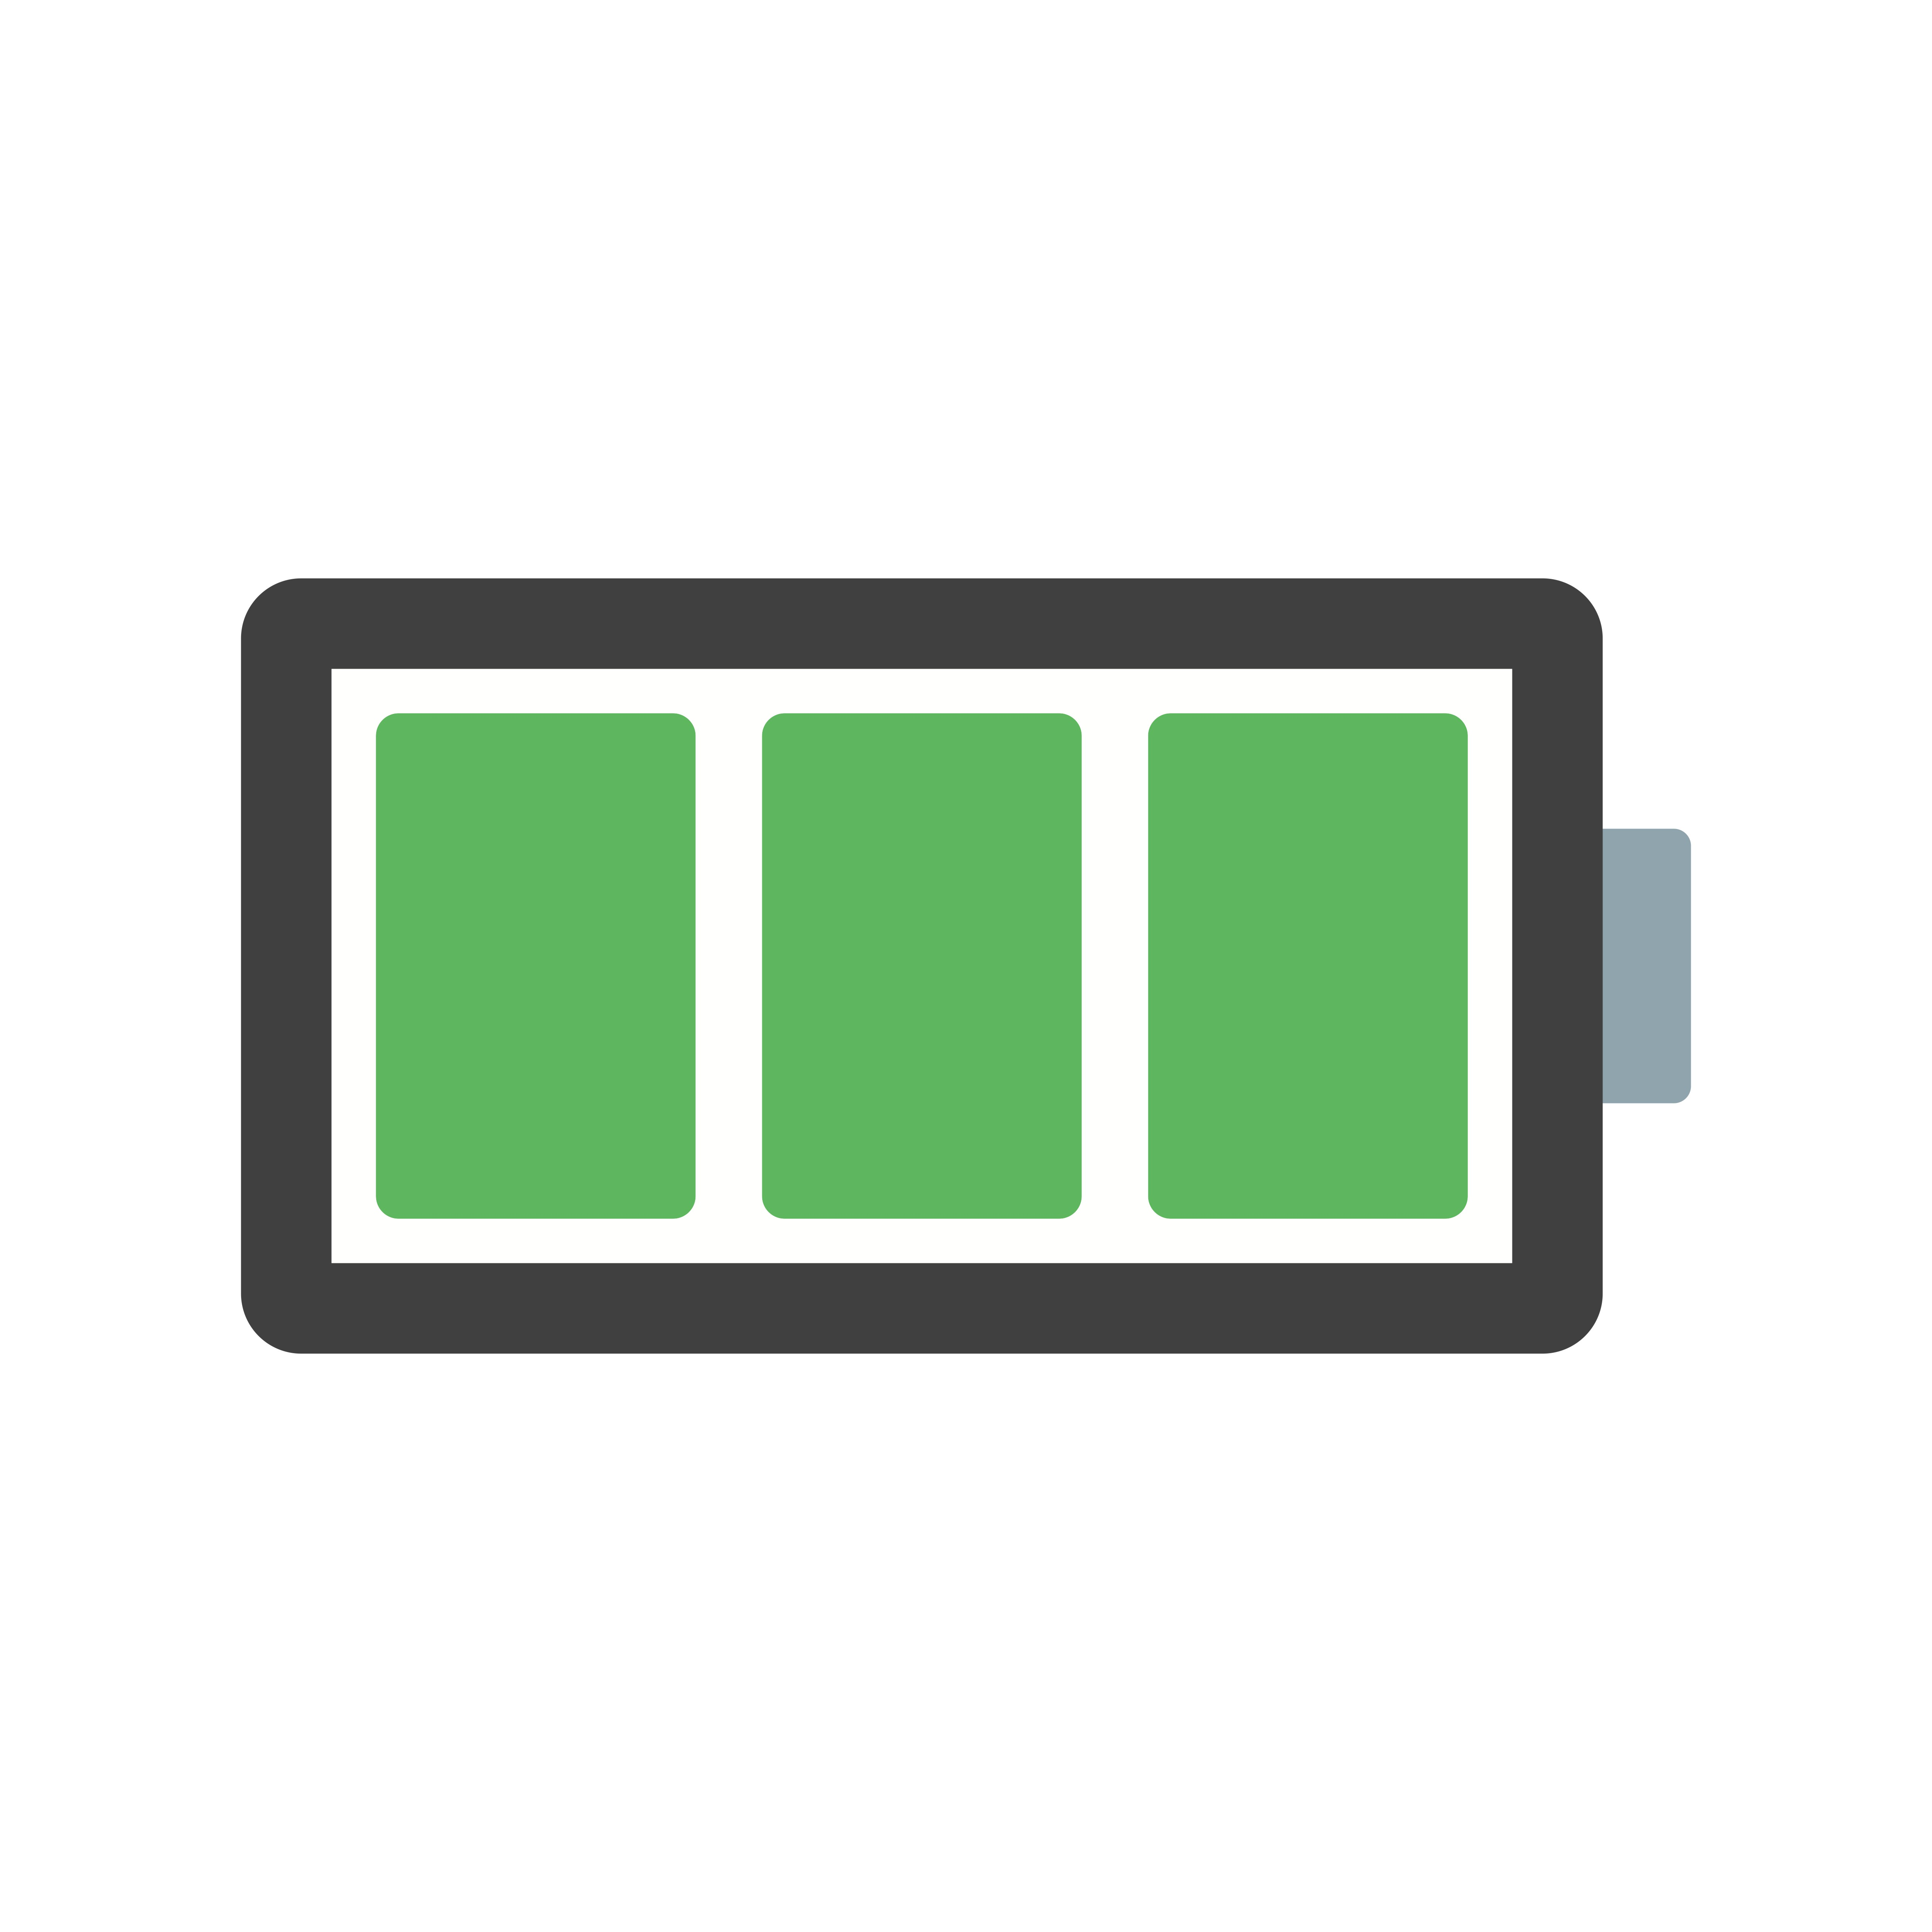


Four major components of IoT device
Computation and Storage
Sensing and Actuation
Power
Wireless Connectivity

Slide 9
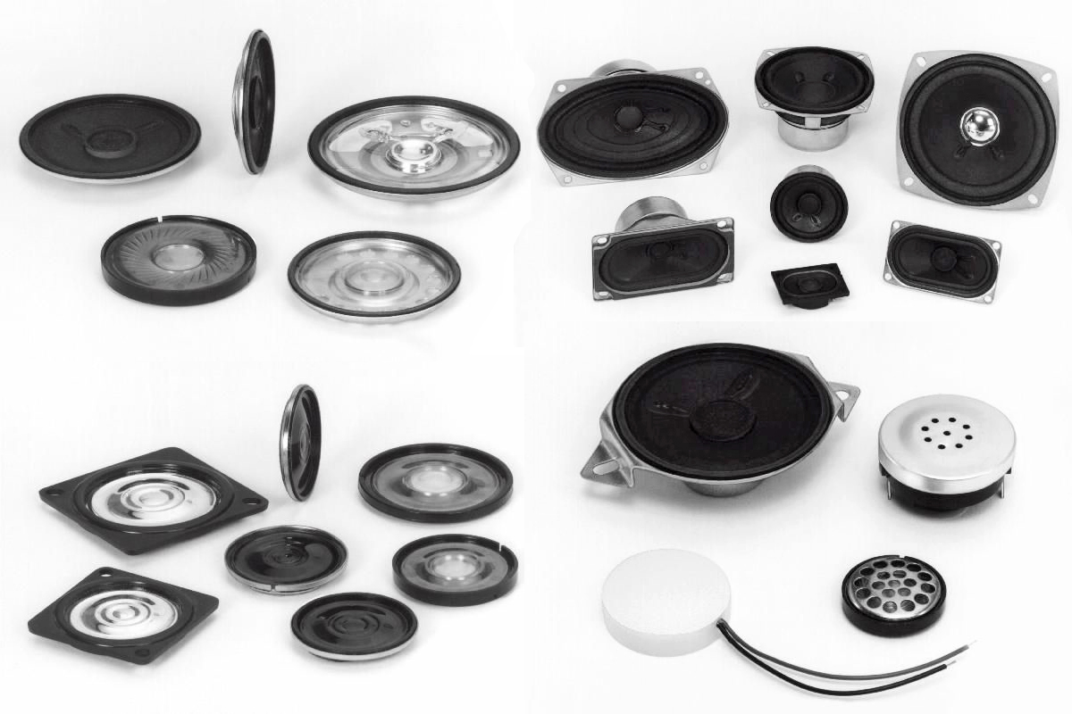
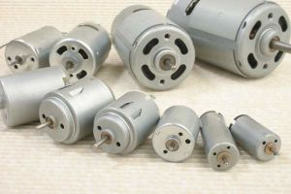
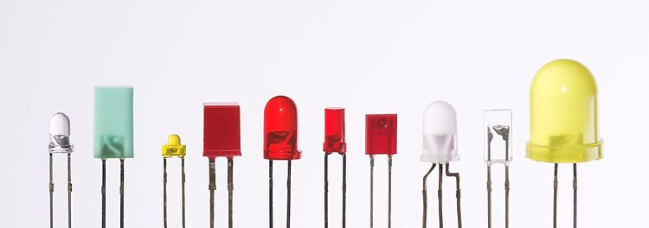
Definitions: What are actuator?
Actuator is a device that modifies a physical quantity
Light/LED
Motor
Speaker
…….
Notes:
Let's begin by discussing Actuators. They are a crucial component in IoT devices, allowing them to modify physical quantities and interact with the environment.
Actuators come in various types, each with its unique function. Some of the most common types include:
Light/LEDs - These emit electromagnetic radiation in the light spectrum, providing us with a visual representation of the world.
Motors - These allow IoT devices to move and physically interact with their surroundings.
Speakers - These generate acoustic signals by emitting sound waves, allowing the device to communicate in the auditory domain.
It is important to note that the choice of the actuator depends on the specific task that the IoT device is designed to perform and the environment in which it will operate. As a result, each type of actuator has its advantages and disadvantages, and selecting the appropriate actuator will play a key role in determining the overall performance and effectiveness of the device.
Typically, actuation is an energy-expensive task.

Slide 10
Definitions: What are sensors?
Sensor is a device that measures a physical phenomenon
Temperature sensor
Humidity sensor
Acoustic sensor
Image sensor
…….
Sensors have become numerous, and are very low-power, and capable
Notes:
Sensors enable the measurement of physical phenomena and play a crucial role in functioning Internet of Things (IoT) devices. Sensors come in various shapes and sizes and allow IoT devices to perceive the world around them.
Over the past few decades, sensors have undergone significant advancements, becoming low-power, capable, and versatile. As a result, sensors are often the lowest power-consuming component in a typical IoT device.
This has enabled the widespread adoption of sensors in various applications, from environmental monitoring to industrial automation.

Slide 11
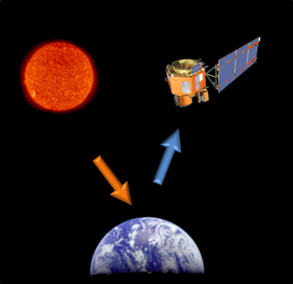
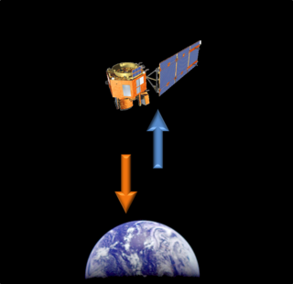
Different forms of sensing: Active vs Passive
Passive Sensing
Active Sensing
Notes:
There are two main types of sensors and sensing methods: active and passive. Active sensors actively emit a signal, which is then reflected off the environment and captured back by the sensor to gather information about the surroundings. In contrast, passive sensors do not emit any

Slide 12
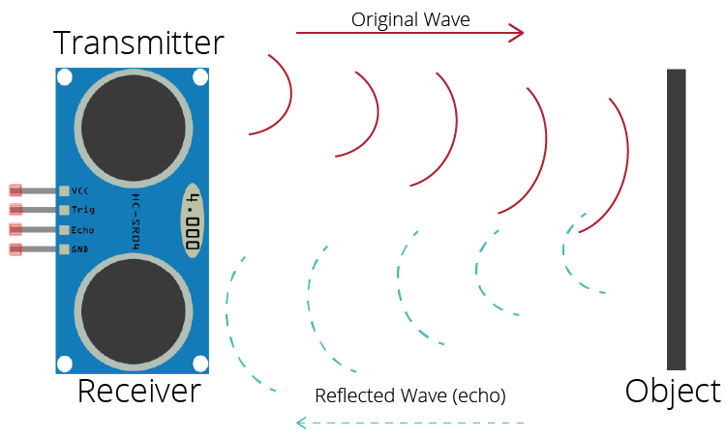
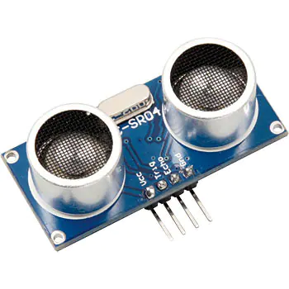
Active sensing: Ultrasound sensor
Emits high frequency sound waves from sensor which bounces from objects that are present in the environment
Estimates distance, proximity by measuring time taken for sounds waves to bounce back and propagate back to the ultrasound device
Power consuming, though can be used on IoT devices
Common application: Robotics, obstacle detection, water level sensing

Slide 13
Sensors transform physical phenomenon into an electric signal
Microcontrollers can only interact with analog (ADC) or digital signals
Generating an electrical signal proportional to a physical phenomenon allows the physical quantity to be sensed by a microcontroller
Most often we are generating an analog electrical signal
How do we generate an electrical signal?
Ohm’s Law: V = I * R (Voltage = Current * Resistance)
Vary one of these three (according to physical phenomenon) and an analog signal is created corresponding to the physical phenomenon

Slide 14
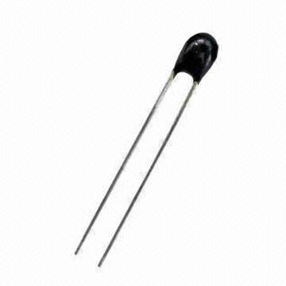
Example: Resistive temperature sensors
Thermistor varies resistance based on temperature
Set up as a voltage divider to measure
Advantages: cheap and easy to use
Disadvantages: non-linear transfer function

Slide 15
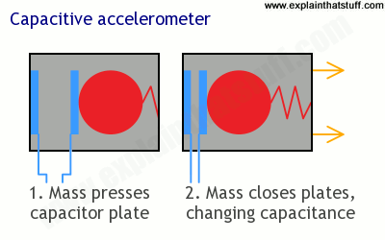
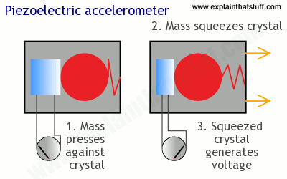
Motion sensing: acceleration
Goal: create a voltage that changes based on force

Slide 16
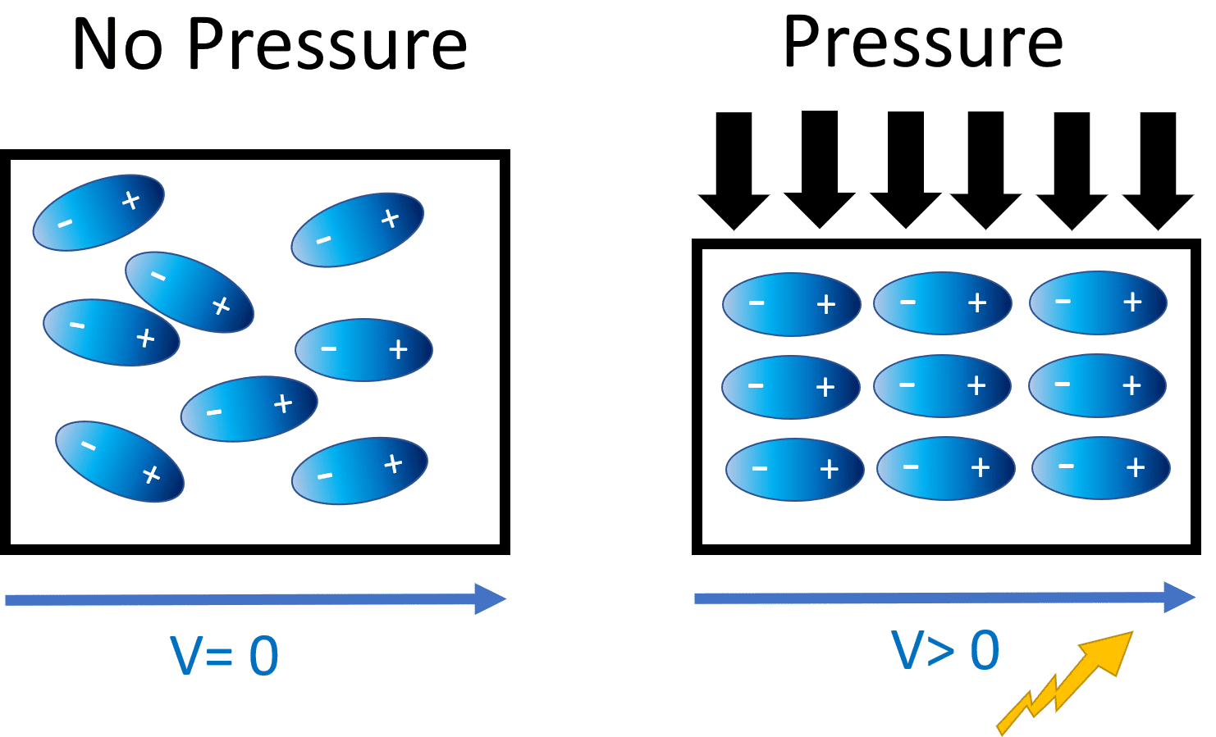
Generating voltage via piezoelectric effect
Compression of the material generates a voltage
Various sources of compression:
Air Pressure
Acceleration
Strain

Slide 17
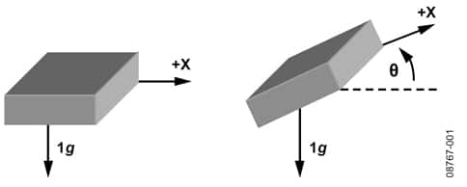
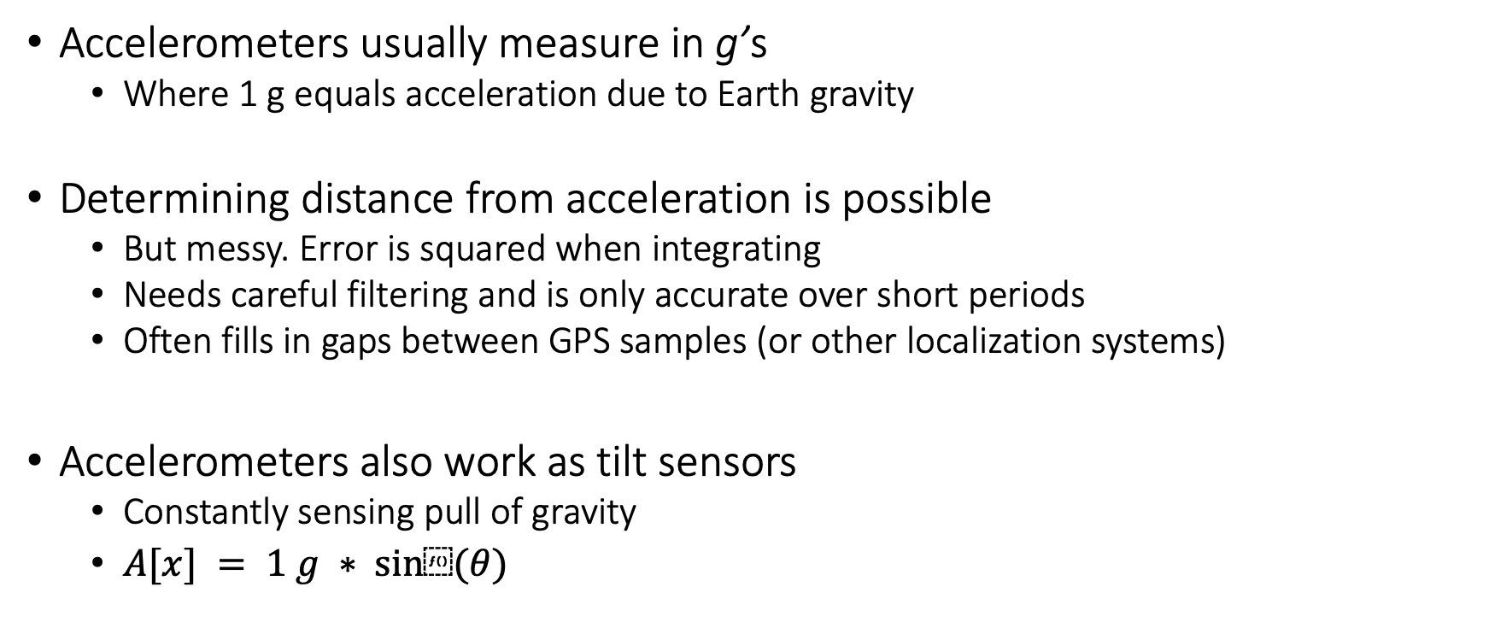
Motion sensing: accelerometers
Accelerometers usually measure in g’s
Where 1 g equals acceleration due to Earth gravity
Determining distance from acceleration is possible
But messy. Error is squared when integrating
Needs careful filtering and is only accurate over short periods
Often fills in gaps between GPS samples (or other localization systems)
Accelerometers also work as tilt sensors
Constantly sensing pull of gravity
$A[x] = 1 g ∗ sin⁡(θ)$

Slide 18
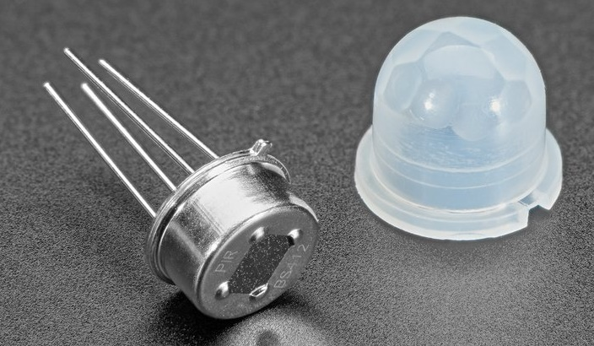
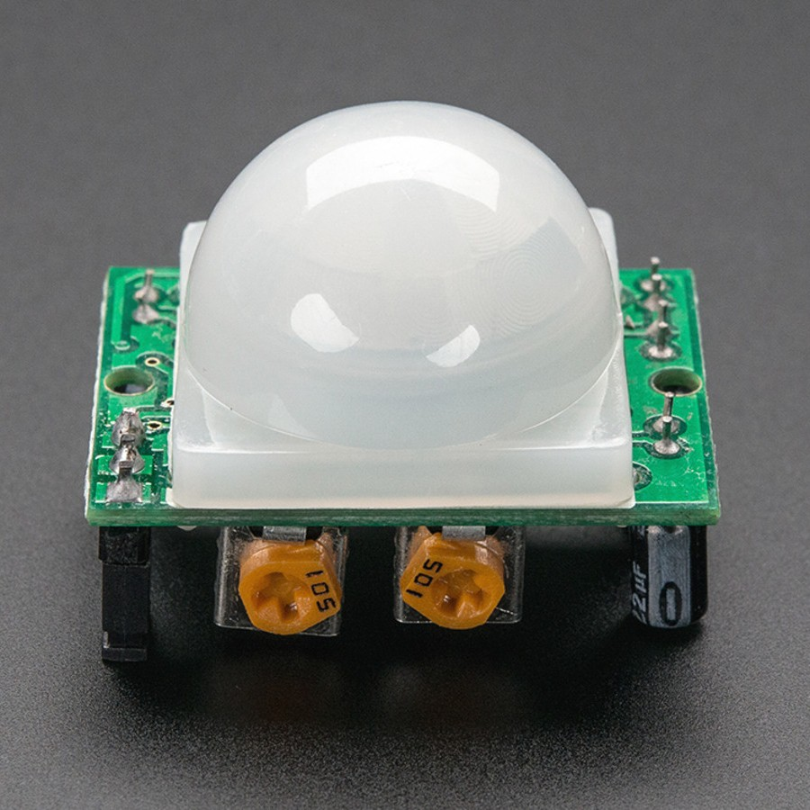
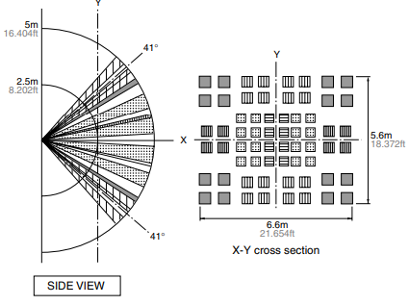
Passive Infrared (PIR) sensor
Detect movement in the environment
By detecting change in IR levels
Often come with plastic lens cover to improve field of view and range

Slide 19
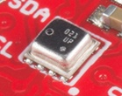
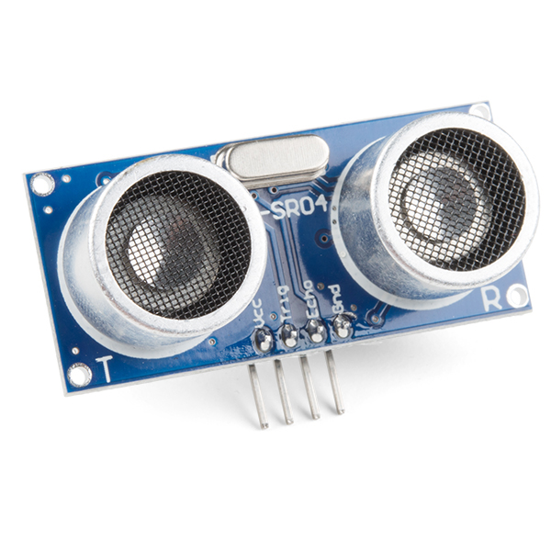
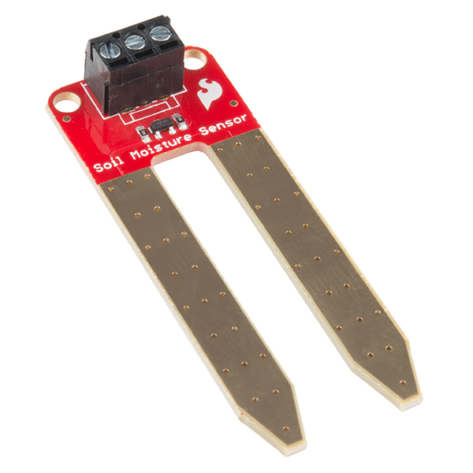
Even more types of sensors
Environment: Pressure, Humidity, Air Velocity, Air Quality
Distance: Ultrasonic, Lidar, or Radar
Biometric: Pulse Oximeter, Heart Rate
Agricultural: Soil moisture

Slide 20
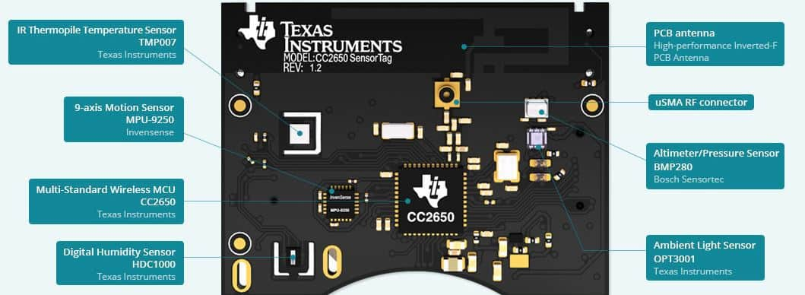
Sensors on SensorTag (CC2650)

Slide 21
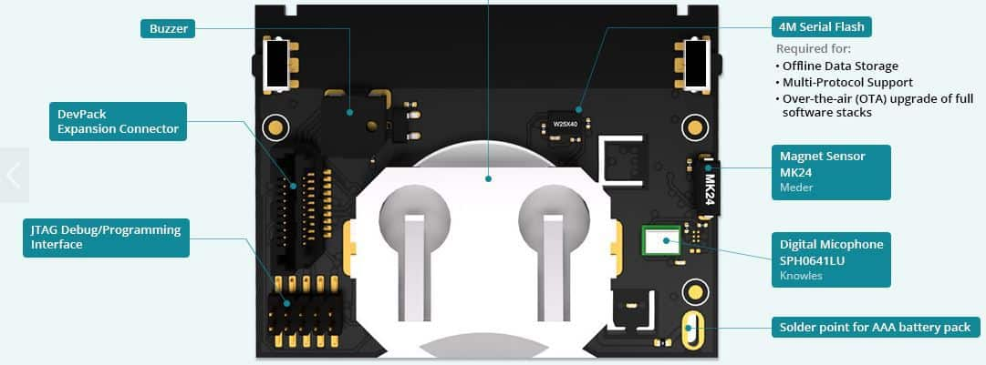
Sensors on SensorTag (CC2650)

Slide 22
Sensing Reading and Processing
Sensor data reading tends to be noisy; you need to “clean” the data before use
Some advice for processing sensor readings:
Take note of the “highest” sampling rate supported by the device, higher does not always mean better
Printf are good for debugging, but too much I/O can slow down the processing significantly
Some smoothing/averaging can be useful (low pass filter)
Do not rely your decision only on a small number of samples

Slide 23
Battery-life, Power Consumption

Slide 24
Terms/Units (Quick Revision)
Voltage: Volts (V): the SI unit of electromotive force
Current: Ampere or “amp” (A) is the SI unit of electric current
Power (W) = volts (V) x amps (A)
Energy (Joule) = Power x Time.
Example:
A device running at 1V draws 1A.
The power consumption is therefore 1W
Energy consumed in 1s is 1J

Slide 25
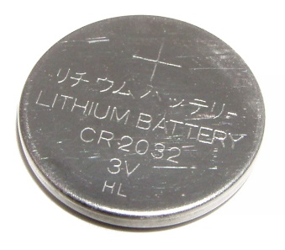
How do you measure battery life?
Battery lifetime: The watt-hour (symbolized Wh) is a unit of energy equivalent to one watt (1 W) of power expended for one hour (1 h) of time.
Example:
Dell Latitude E7440 Laptop (3 cell): 34Wh - provides 1W for 34 hours.
iPad2: 25 watt-hour
An ampere-hour or amp-hour (Ah) is a unit of electric charge equal to the charge transferred by a steady current of 1A flowing for one hour,
iPad2 6930mAh, voltage = 25Wh/6.9Ah = 3.6V
Samsung S4: 2600mAh (3.7V), 9.62Wh
AA Energizer Alkaline: 2500 mAh (1.5V), 3.75Wh
Calculator Battery (CR2032): 225 mAh (3V), 0.675Wh

Slide 26
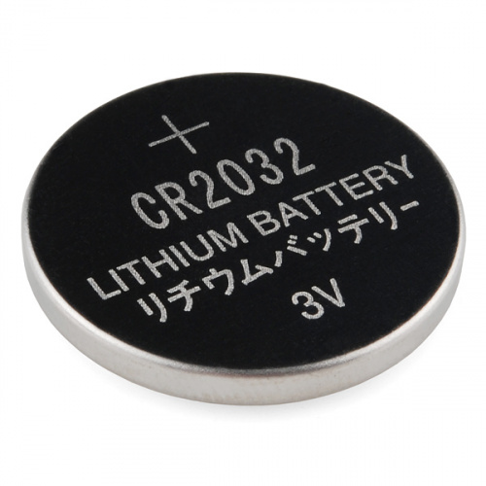
What is the capacity of the battery?
How do we calculate the lifetime of the battery in IoT devices?
We express battery capacity commonly in milliampere-hour (mAH)
Coin cell (CR2032): 240 mAh, Flexible battery (Molex): 10 mAh
How long would battery last under different device load:
Current drawn | Lifetime
240 mA | 1 h
120 mA | 2 h
1 mA | 240 h
Coin cell battery
CR 2032 (240 mAh)

Slide 27
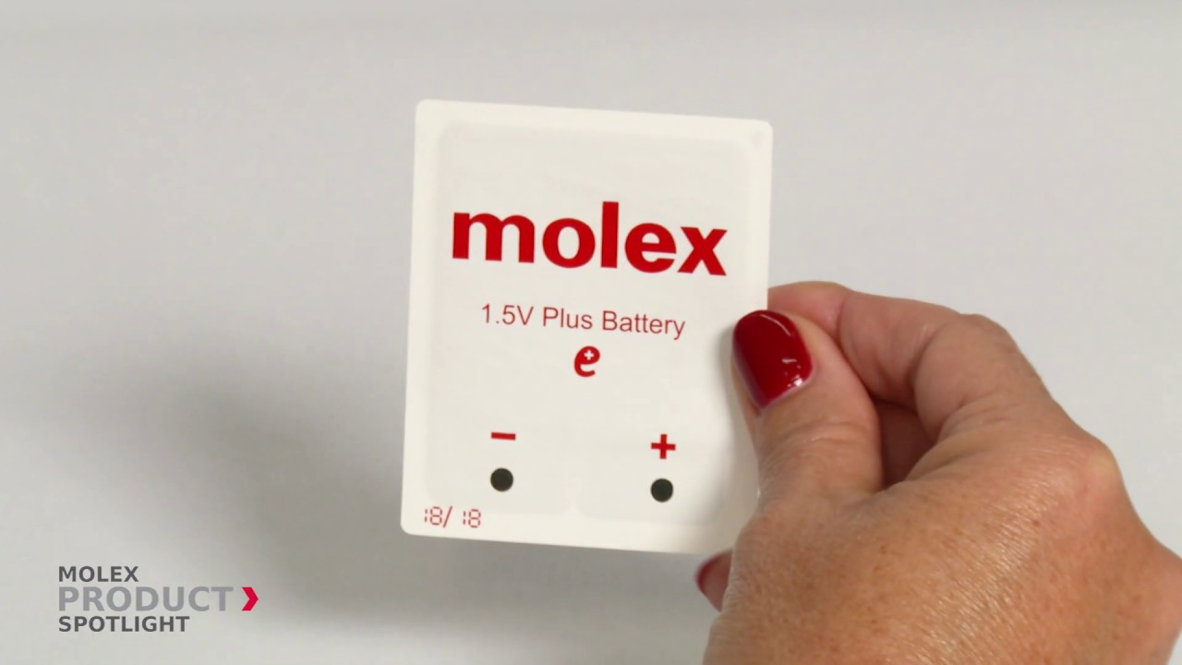
Expected lifespan of a battery in an IoT devices?
Coin cell (CR2032): 240 mAh, Flexible battery (Molex): 10 mAh
What is the battery life under different device loads:
Coin cell battery
CR 2032 (240 mAh)
Flexible Battery
(10 mAh)
Component | Current draw
Microcontroller | 200 uA
Accelerometer | 10 uA
WiFi Radio | 15 mA
Bluetooth radio | 1 mA

Slide 28
Expected lifespan of a battery in an IoT devices?
Coin cell (CR2032): 240 mAh, Flexible battery (Molex): 10 mAh
What is the battery life under different device loads:
Coin cell battery
CR 2032 (240 mAh)
Flexible Battery
(10 mAh)
Component | Current draw | Flexible Battery | Coin cell
Microcontroller | 200 uA | 50 h | 1200 h
Accelerometer | 10 uA | 1000 h | 24000
WiFi Radio | 15 mA | 45 mins | 16 h
Bluetooth radio | 1 mA | 10 h | 240 h

Slide 29
Energy Characteristics of LCD Display [4]
Most of the power in an LCD display is consumed by the backlight, the light filter requires comparatively less power.
B Anand, K Thirugnanam, J Sebastian, PG Kannan, AL Ananda, MC Chan, RK Balan, “Adaptive display power management for mobile games,” ACM International Conference on Mobile Systems, Applications, and Services (Mobisys) 2011.

Slide 30
Energy Characteristics of OLED Display [4]
OLED display functions without a backlight
OLED displays consume less power than a LCD display when the image is dark, but more when the image is bright
Displaying different color consumed different amount of energy

Slide 31
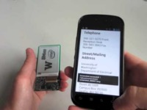
Wirelessly Powered Display

Slide 32
Power Consumption for Wireless Networking

Slide 33
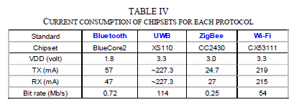
Energy consumption for wireless networking
Table taken from Jin-Shyan Lee, Yu-Wei Su, and Chung-Chou Shen, “A Comparative Study of Wireless Protocols: Bluetooth, UWB, ZigBee, and Wi-Fi,” IECON, 2007
A mobile device with a battery capacity 9.62Wh transmits continuously on:
WiFi:
Considering only network energy consumption
Power consumption: 3.3V*219mA = 722.7 mW
Duration = 9.62/0.7227 = 13.3hrs
In practice, the duration is much shorter due to energy consumed by other components
Bluetooth: (1.8V * 57mA = 102.6mW)
Duration = 9.62/(1.8*0.057) = 93.76hrs

Slide 34
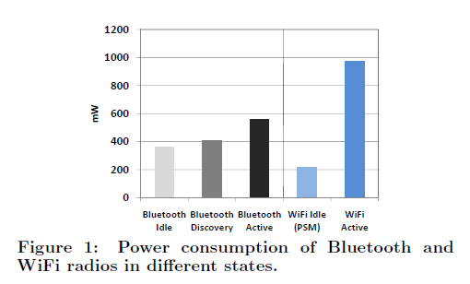
Energy consumption for wireless networking
Devices rarely transmit continuously.
Having different power states allow power consumption to be reduced
Ashish Sharma, Vishnu Navda, Ramachandran Ramjee, Venkat Padmanabhan, and Elizabeth Belding, Cool-Tether: Energy Efficient On-the-fly WiFi Hot-spots using Mobile Phones, in CoNEXT 2009.

Slide 35
Wi-Fi power consumption on a Samsung Galaxy S4
WiFi state transition for beacon communication is (relatively) fast
However, state transition for data communication is (still) slow due to driver/software overhead

Slide 36
“Classic” Bluetooth power consumption and timing
Always-on, short range radio
Initially design as a way to let laptop make calls over a mobile phone
Data Rate: 1Mbps - 3Mbps
Three classes
Class 1: 100mW
Class 2: 2.5mW
Class 3: 1mW
ISM band 2.4GHz (2.402GHz – 2.480GHz)
TDD, Master-slave polling
Supports synchronous and asynchronous traffic
Point-to-point
https://www.bluetooth.com/learn-about-bluetooth/radio-versions/

Slide 37
“Classic” Bluetooth power consumption and timing
“Classic” Bluetooth Timing Considerations
New slave enumeration = >3s, typically 20s
Sleeping slave changing to active = 3s typically
Active slave channel access time = 2ms typically

Slide 38
Bluetooth Low Energy (BLE)
Data Rate: 125Kbps – 2 Mbps
Classes
Class 1,1.5: 10-100mW
Class 2: 2.5mW
Class 3: 1mW
ISM band 2.4GHz (2.402GHz – 2.480GHz)
Point-to-point, broadcast, mesh
https://www.bluetooth.com/learn-about-bluetooth/radio-versions/

Slide 39
Bluetooth Low Energy (CC2640)
Tx Current: ~ 6.1mA (0dBm)
Tx Current: ~ 15mA
Latency: 3 ms
Sleep current ~ 1µA
Designed for sending small chunks of data
J. Lindh, Measuring Bluetooth Low Energy Power Consumption; Application Report, Texas Instruments, 2017.

Slide 40
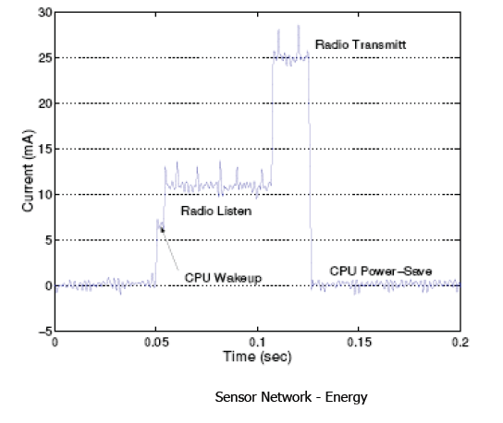
Current Consumption (MICA2 Sensor node)
What are the desirable properties for radio to operate in low power?

Slide 41
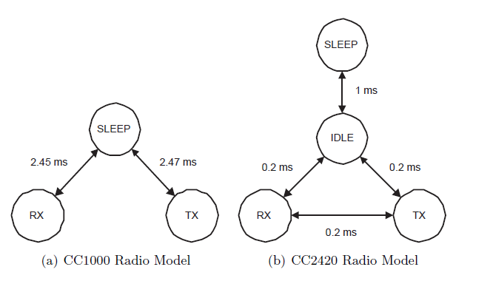
Example of Different Radio States
Energy can be saved by putting the network interfaces into low power states when they are not active

Slide 42
Cellular Network: 3G/4G Radio State
State transition in cellular network incurs high overhead
Radio stays in high power states in anticipation of data transfer

Slide 43
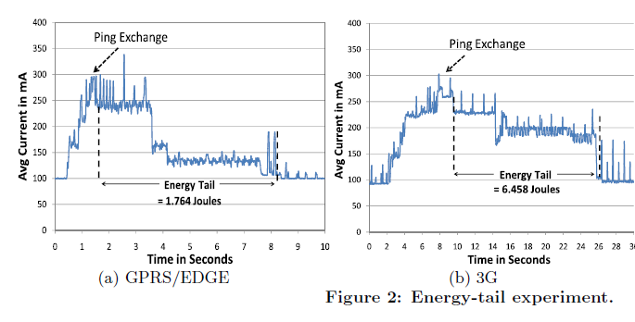
Cellular “Tail” Behavior
This “tail” behavior causes cellular radio to be very inefficient for infrequent transfer of small amount of data

Slide 44
Examples of Duty Cycling (Network Interface)
Compare WiFi (100Mbps) and ZigBee/802.15.4 (250kbps), 1s cycle, assume same voltage
WiFi, three states;
Transmit: 280mA
Receive: 180mA
Idle: 10mA
802.15.4, three states:
Transmit: 30mA
Receive: 18.mA
Idle: 0.426mA

Slide 45
Examples of Duty Cycling (Network Interface)
100% utilization (50% transmit, 50% receive)
WiFi: (180+280)/2 = 230mA
802.15.4: (18.8+30)/2 = 24.4mA (10.6% of WiFi)
10% utilization (5% transmit, 5% receive, 90% idle)
WiFi: 230*0.1 + 10*0.9 = 32mA
802.15.4: 24.4*0.1 + 0.426*0.9 = 2.823mA (8.8% of WiFi)
1% utilization (0.5% transmit, 0.5% receive, 99% idle)
WiFi: 230*0.01 + 10*0.99 = 12.2mA
802.15.4: 24.4*0.01 + 0.426*0.99 = 0.6657mA (5.46% of WiFi)

Slide 46
Examples of Duty Cycling (Network Interface)
Wakeup 10s, sends 10,000 bytes of data
WiFi (no overhead)
Transmit time = 10*8/100000 = 0.8ms
Average current drawn
(280*0.0008 + 10*9.9992)/10 = 10.0216mA
802.15.4 (no overhead)
Transmit time = 10*8/250 = 320ms
Average current drawn
(30*0.32 + 0.426*9.68)/10 = 1.372mA

Slide 47
Power Modes of CC2650 Device
ARM Cortex-M3: operating frequency up to 48MHz, current in ACTIVE state varies from 1.45mA to 3mA
For comparison,
RaspberryPi 3 (ARM Cortex-A53): 1W - 2W
I7-7600U@2.8GHz (laptop): 7.5W (down), 15W (typical), 25W (up)
I7-7700@3.6GHz (desktop): 65W (typical)

Slide 48
Sensor Energy Characteristics
Sensor | Galaxy S3 | Galaxy Nexus
Accelerometer | 0.23mA | 0.139mA
Light | 0.2mA | 0.75mA
Pressure | 0.045mA | 0.67mA
Proximity | 1.3mA | 0.75mA
Magnetic field | 6.8mA | 4.0mA
Gyroscope | 6.1mA | 6.1mA
Orientation | 7.8mA | 10.2mA
Energy savings mechanisms:
Reduce sampling frequency
Use low power sensors whenever possible
Offload to hardware (sensor batching)

Slide 49
Case Study: Mobile Phone

Slide 50
Reference:
Aaron Carroll and Gernot Heiser. 2013. The systems hacker's guide to the galaxy energy usage in a modern smartphone. In Proceedings of the 4th Asia-Pacific Workshop on Systems (APSys '13). ACM, New York, NY, USA, , Article 5 , 7 pages. DOI=http://dx.doi.org/10.1145/2500727.2500734
A. Caroll, etal, “An Analysis of Power Consumption in a Smartphone,” USENIX Annual Technical Conference, 2010.
A detail power analysis of various components in a smartphone
Question: How much of the system’s energy is consumed by which parts of the system and under what circumstances?

Slide 51
Power measurement for mobile phones
Detail power analysis enables more effective energy management
Fine grained power measurement is challenging
Requires information/knowledge of schematics
Target: Samsung Galaxy S III GTI9300 (S3) smartphone

Slide 52
Mobile phones: Airplane Mode (805mW)
System-on-Chip
- MIF (memory interface),
- INT (internal),
- SoC (remaining miscellany).

Slide 53
Mobile phones: Gaming (No network traffic)

Slide 54
Mobile phones: Video Playback (No network traffic)

Slide 55
Mobile phones: Voice Call vs. SMS

Slide 56
Mobile phones: Web Browsing

Slide 57
Mobile phones: Sensors

Slide 58
Mobile phones: maximum power cosumption

Slide 59
Battery technology, capacity, and density
Battery Technology | Watt hours/gram
Lithium-Ions in chemical batteries | 0.3
Methanol in fuel cell | 3.0
Tritium in nuclear batteries | 850.0
Polonium-210 in nuclear batteries | 57000.0
Thomas Haenselmann, Wireless Sensor Networks: Design Principles for Scattered Systems, Oldenbourg Verlag, 2011.

Slide 60
Example: IoT Platform Calculation

Slide 61
Energy consumption/Lifetime for a IoT device
Sample values
Basic Energy consumption : 10mA
Transmitting (PTX) : 20mA
Receiving (PRX) : 10mA
Sleeping : 0.1mA
Battery = 2 (1.5V) AA batteries, each provides 2300 mAh
Total battery power = 2 * 1.5 * 2.3 = 6.9Wh

Slide 62
Energy consumption/Lifetime for a IoT device
Clock is 10MHz
1 clock cycle = 0.1ms
Assume
average instructions takes 4 clock cycles
task takes 5000 instructions
Time taken = 4 * 5000 * 0.1 = 2ms
Current drawn
= Current * Time
= 10 * 2 = 0.02mAs

Slide 63
Energy consumption/Lifetime for a IoT device
Bandwidth available 250kbps
Total data transmitted = 50 bytes
Time taken = (50 * 8)/250000 = 1.6ms
Current drawn (transmit + CPU) = 30mA
Current drawn
= 30 * 1.6
= 0.048mAs

Slide 64
Energy consumption/Lifetime for a IoT device
Duration of active period (compute + transmit) = 3.6ms
Current drawn per cycle = 0.02 + 0.048 = 0.068mAs
Let sensor node operates continuously:
Current drawn = 0.068 mAs /0.0036 = 18.89mAs
Lifetime = (2300*3600) mAs / 18.89 = 438,327s or 122hr or ~5days

Slide 65
Energy consumption/Lifetime for a IoT device
Let sensor node operates once a second
Idle period = 0.9964s
Current drawn during idle period = 0.1 * 0.9964 = 0.09964mAs
Average current drawn (over 1 s) = 0.068 + 0.09964 = 0.1676mAs
Lifetime = (2300*3600) mAs / 0.1676 = 13,723hr or 572days

Slide 66
Low-Power Wireless Transmissions through Backscatter Communication

Slide 67
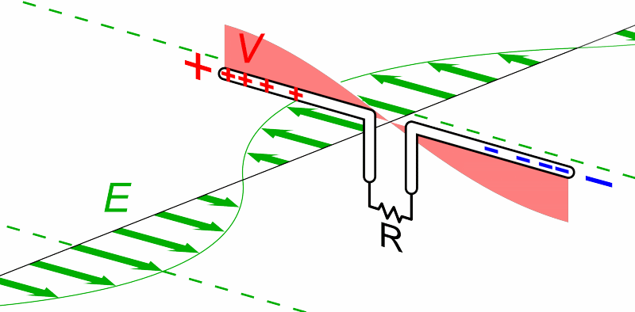
Review: What are Antennas?
High level: They convert between electric and magnetic field
Animation by Chetvorno - Own work, CC0, https://commons.wikimedia.org/w/index.php?curid=40789783
Notes:
Why do the IoT platforms suffer from this energy challenge? To understand this, we investigate the architecture of the IoT device. We show this architecture in the figure on the slide. It consists of a series of stages that enable us to sense physical phenomena, process and transmit the sensor information through a transceiver such as ZigBee/BLE/LoRa.
This architecture has remained unchanged over the past two decades. We find that during this time, sensors have become exceeding efficient. Today, we find sensors such as an accelerometer or a temperature sensor consumes just a few tens of microwatts of power consumption. However, we find that rest of the architecture components that are shown in red colour remain significantly energy expensive. To understand the reason for this significant energy asymmetry, we look at the following slide.

Slide 68
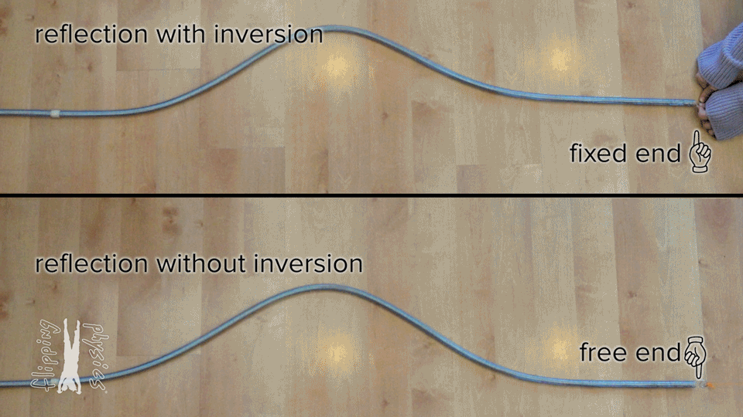
What happens if nothing ‘receives’ the wave?
From: https://www.flippingphysics.com/standing-waves.html

Slide 69
”Fixed end” and “Free end” in transmission
~
Short Circuit = “Free End”
- Reflects wave
~
Open Circuit = “Fixed End”
- Inverts wave
~
Matched Load
- Absorbs wave (no reflection)

Slide 70
Basics of backscatter communication
Vary between absorbing or reflecting signal to modulate data
Wireless transmissions at microwatts of power draw (10000x energy savings)
Frequency bands: 400 MHz, 900 MHz, 2.4 GHz
Ambient RF signal
Antenna
Reflected (backscatter) signal
RF Switch
Modulating Signal (Digital)
Backscatter tag
Reader/ Receiver

Slide 71
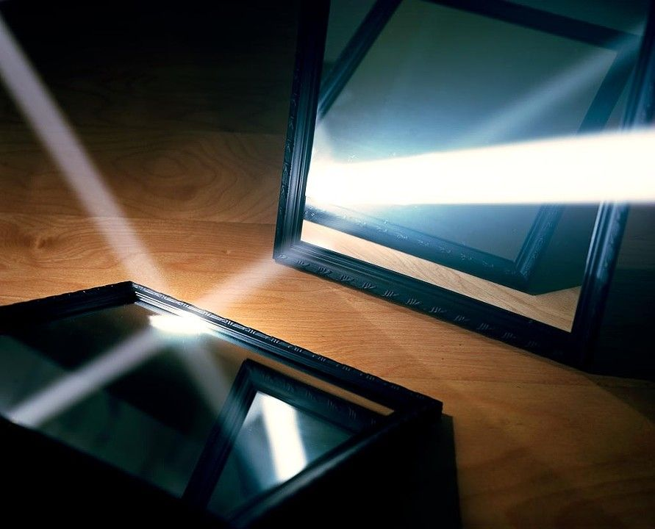
One way to understand backscatter transmissions
Notes:
++ While we are deploying an enormously large number of IoT devices, I claim that very little attention is being paid to their energy challenge.
++ Today, most IoT devices are very energy expensive, and consequently, they rely on bulky batteries such as AA/AAA sized batteries for their operation. Even when operating on these batteries, they require frequent replacement of the exhausted batteries. This can be challenging when performed at a massive scale, especially considering that we may have a trillion embedded device deployed in the world.
++ Further, it can also harm the environment. These batteries use toxic chemicals, which means now we can have billions of toxic chemicals laden batteries that would be disposed of in landfills. This is especially important as sustainability has become an essential aspect across the world; in fact, imperial college was celebrating sustainability week.

Slide 72
Backscatter transmits at (up to) 10000x lower power consumption than conventional radios
Backscatter through absorption or reflection of ambient wireless signals enables wireless transmissions at microwatts of power consumption
Ambient RF signal
Antenna
Reflected (backscatter) signal
RF Switch
Modulating Signal (Digital)
Backscatter tag
Receiver
Notes:
Backscatter communication actually help us overcome this limitation

Slide 73
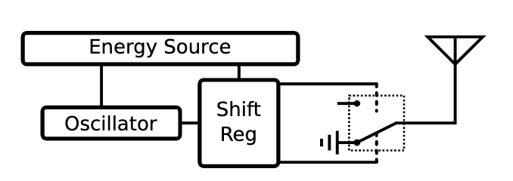
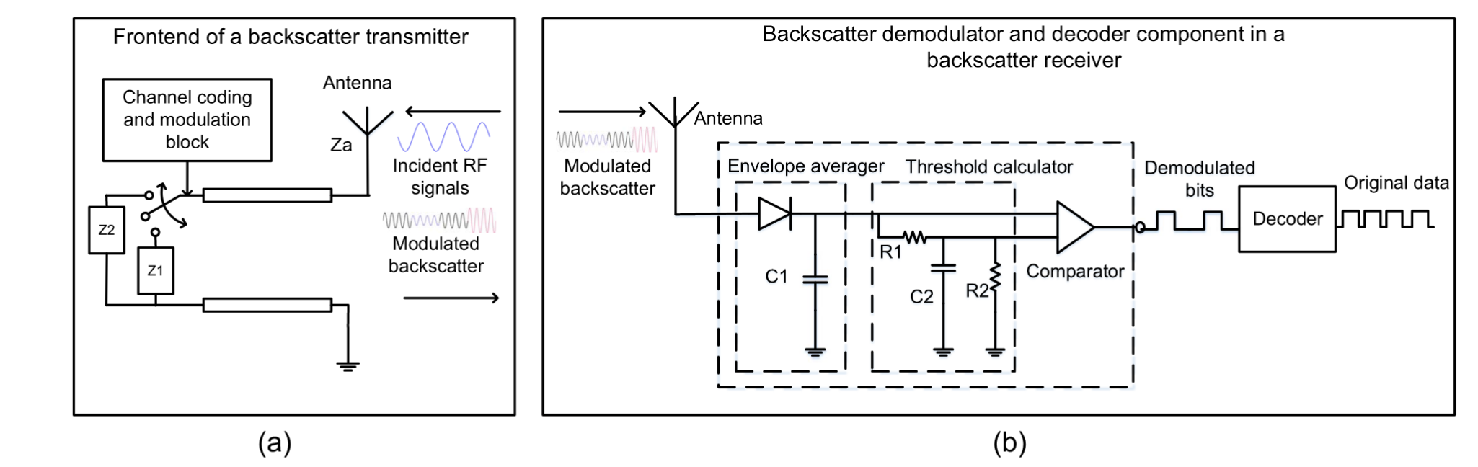
Backscatter radio designs
Simple versions just ‘reflect or don’t reflect’
Modern designs can do more advanced modulation as well
https://ieeexplore.ieee.org/stamp/stamp.jsp?arnumber=8368232

Slide 74

Reflecting FM Signals for Transmissions
Courtesy: University of Washington, Seattle
FM Backscatter: Enabling Connected Cities and Smart Fabrics, USENIX NSDI 2017

Slide 75
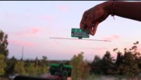
Reflecting TV Signals for Transmissions
Courtesy: University of Washington, Seattle
Ambient Backscatter: Wireless Communication Out of Thin Air, ACM SIGCOMM 2013

Slide 76
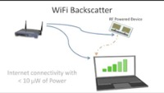
Reflecting WiFi Signals for Transmissions
Courtesy: University of Washington, Seattle

Slide 77
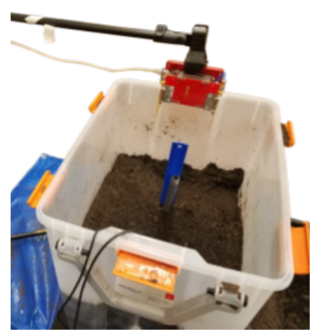
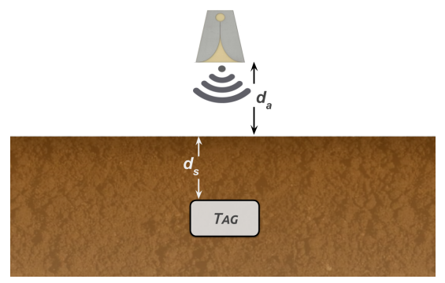
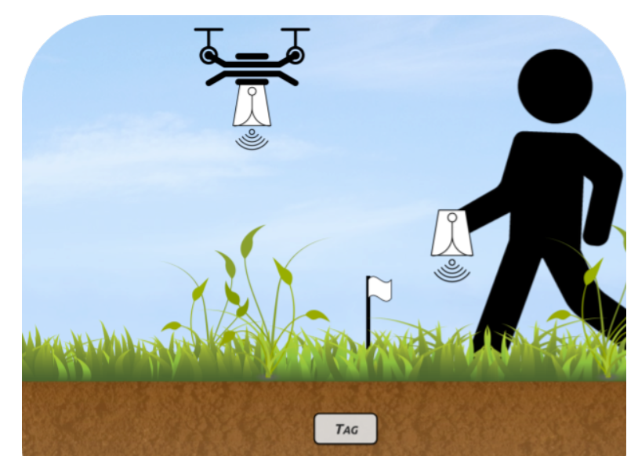
Backscatter as a sensor: soil moisture
Idea: bury backscatter tags in soil
Measure round-trip-time for signal to reflect
T_{s} (time signal travels through ground) changes based on the moisture in the soil
Josephson, Colleen, et al. "Low-cost In-ground Soil Moisture Sensing with Radar Backscatter Tags.“ COMPASS 2021

Slide 78
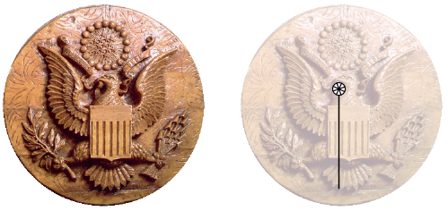
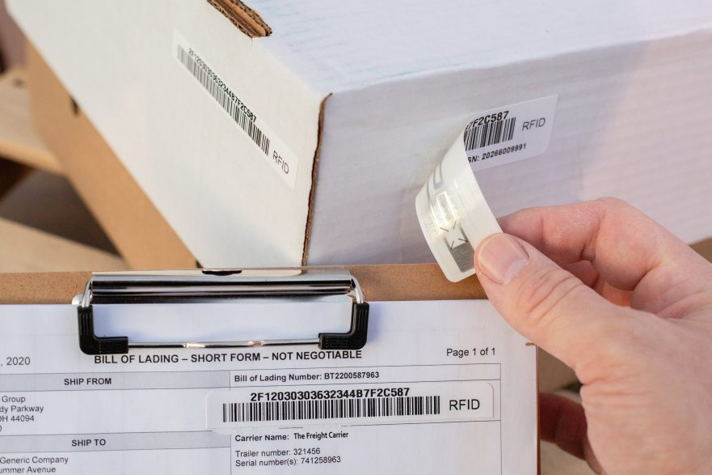
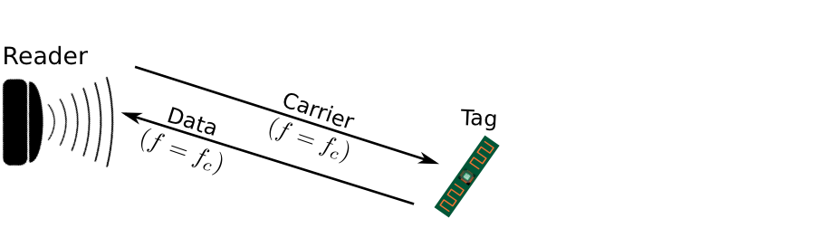
Backscatter is not a new transmission mechanism
First backscatter system: Great seal bug (The Thing) 1945
RFIDs: one of the most widely deployed backscatter system
Great Seal Bug (Backscatter device embedded for spying)
RFID System

Slide 79
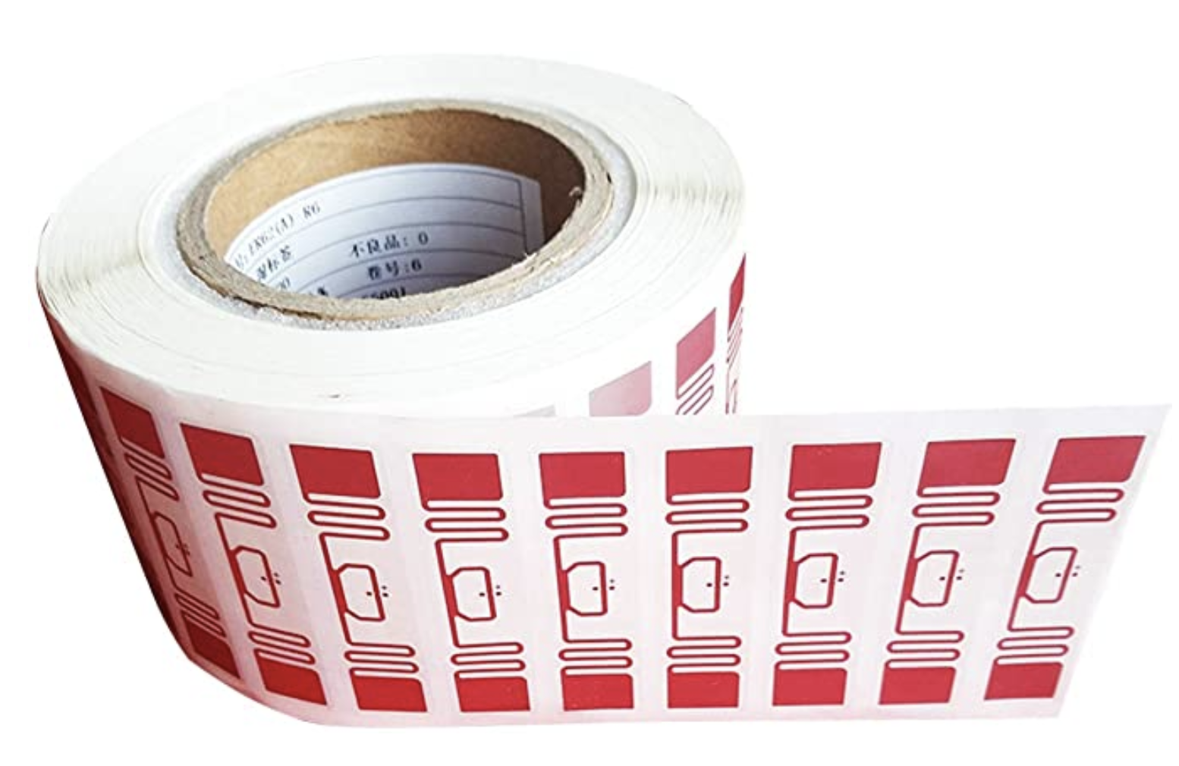
RFID is everywhere nowadays
Fundamental design principle is asymmetry
Extremely simple, cheap tags
Complex readers

Slide 80
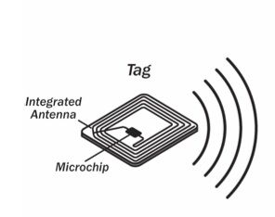
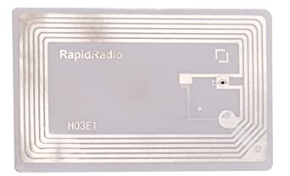
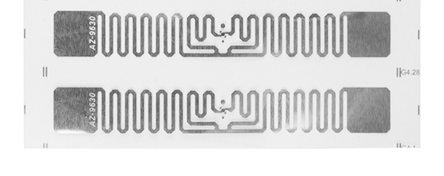
Radio Frequency ID
Cheap, low-power ubiquitous communication
RFID tags on (or in) products
NFC communication to/from smartphone
Requirements
Need to transmit small amount of data (ID)
Need to operate with little or no energy
Most do not have batteries
Short interaction time (fast enough bit rate)
Range can be extremely limited
Meters to centimeters (or millimeters)

Slide 81
Let’s look at RFID standards to get a sense of the numbers
Low Frequency (~300 kHz) — mostly legacy
~10cm read range (inductive coupling)
High Frequency (3~30 MHz; often 13.56 MHz)
Passive: 4~7 m max
Semi-Passive: 10~30 m max
Active: 30+ m
Ultra-High Frequency (300 MHz ~ 3 GHz)
Passive: Up to 12 m (backscatter)
Active: Up to 100 m

Slide 82
RFID challenges
Essentially free communication!
What’s the cost (besides having a higher-capability device)
Difficult to reflect energy when it is already so low
Essentially double the path loss (there and back)
Range is very limited (or transmit power needs to be high)
Meters of range, maximum
Centimeters for inductive coupling
Alternatively, could decouple signal generation from reception

Slide 83
Long-range Backscatter Communication
Notes:
++ Over the past few years, I have designed several backscatter and beyond backscatter systems that precisely overcome these critical challenges that have limited the widespread deployment of backscatter on IoT devices.
++ The research vision that I have pursued and would like to pursue as a faculty member is to enable a massive deployment of IoT devices by bridging the energy asymmetry between sensing, computation and communication blocks by designing novel platforms and communication mechanisms. I am going to describe some of my research contributions next.

Slide 84
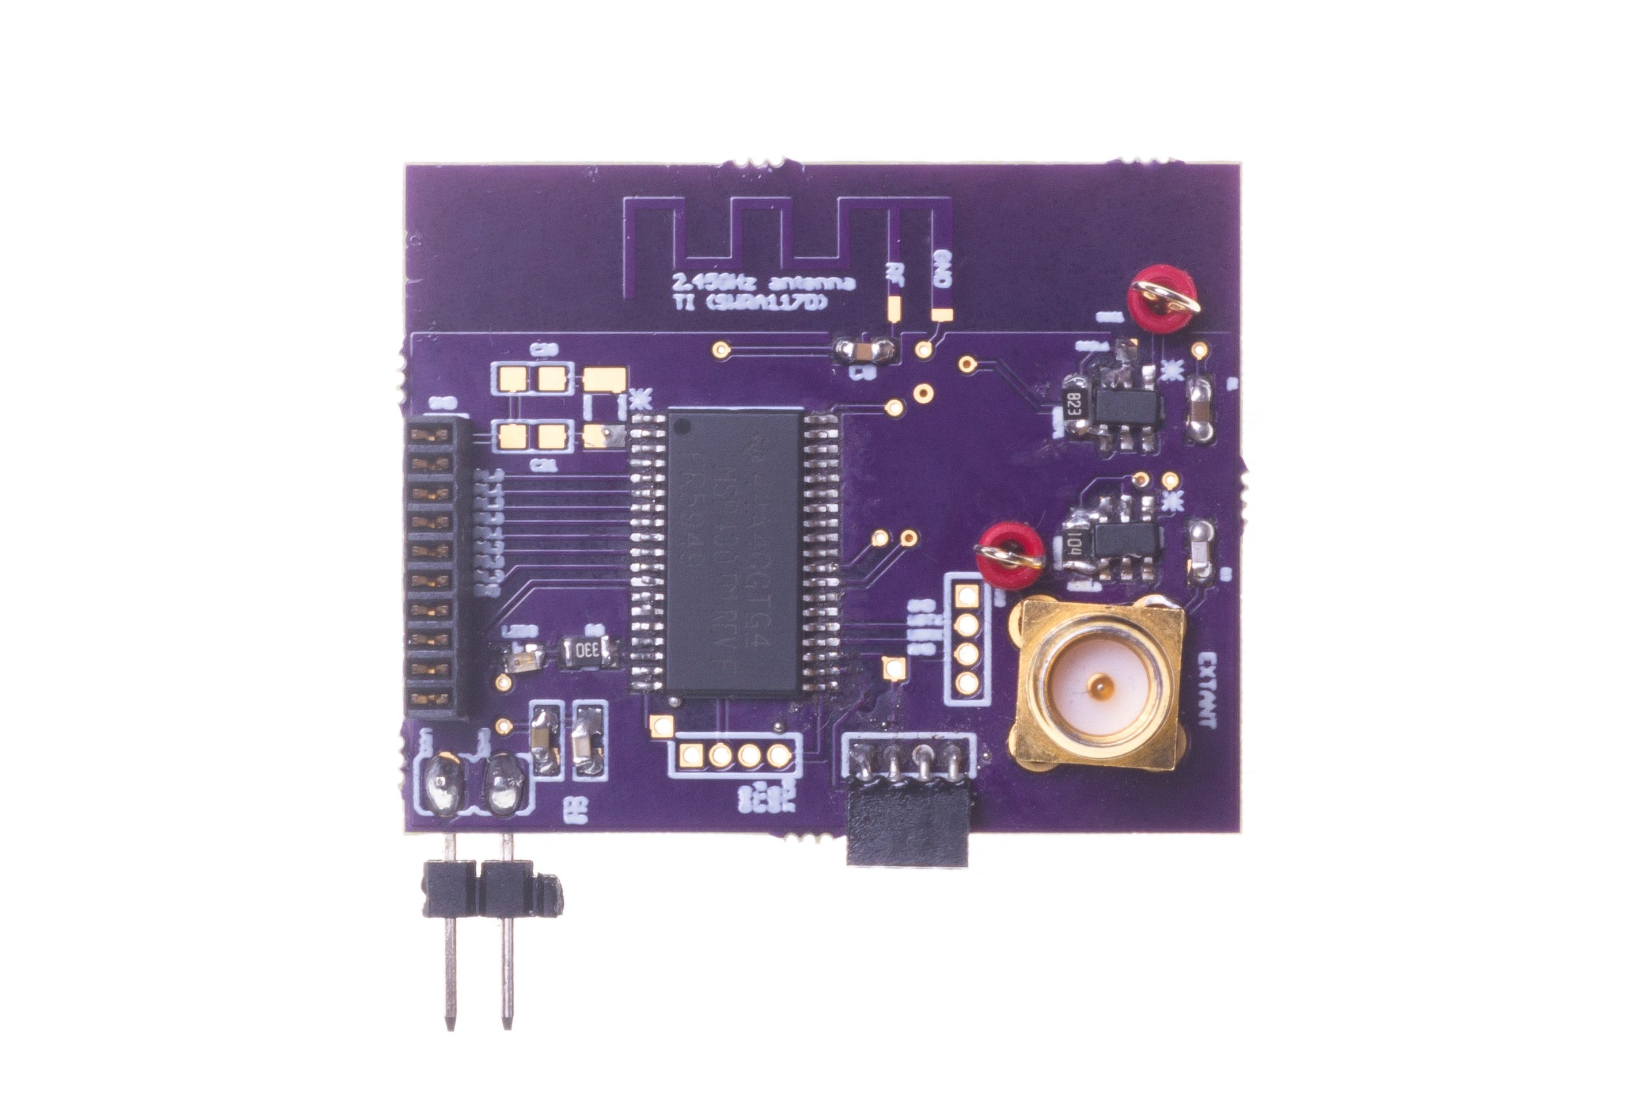
Long range backscatter transmissions using LoRea
LoRea is a long range, low-power, and low-cost backscatter architecture
System Overview
Backscatter Tag Hardware Prototype
(Peak Power of 70 µW)
Varshney et al. ”LoRea: A Backscatter architecture that achieves a long communication range” ACM SENSYS 2017
Notes:
+ Over the past several years, I have designed systems that overcome these critical limitations that have hindered the backscatter systems and have the prevented widespread adoption of the backscatter mechanisms on the Internet of Things devices. One of these systems is LoRea.
+ LoRea was presented at ACM SENSYS, which is a flagship conference in the area of embedded sensor systems. I show the architecture of LoRea on the left-hand figure on the slide. It consists of one or more commodity devices such as a smartphone or Wi-Fi router that provides the necessary carrier signal to support backscatter transmissions, a low-power backscatter tag that I had designed and transmit at a peak power of 70uw, and one or more receiver of backscatter transmissions.
+ The key highlight of LoRea was that it could achieve a significantly larger communication range than existing systems, was designed using off the shelf components and cost (few tens of USDs). Further, the backscatter tag could achieve this capability at orders of magnitude lower energy than commercially available radio transceivers.
+ How did LoRea achieve this capability? We would describe next.

Slide 85

Design element #1: LoRea decouples the carrier signal generation and reception
Bi-static setup spatially separates carrier generation from the receiver
Use devices that surround us for providing the necessary carrier signal
Self-interference reduced due to path loss suffered by carrier signal
Monostatic configuration
Bi-static configuration
Notes:
+ If we look into a RFID reader's configuration, there is a single device that both receives the backscatter transmissions and generates the necessary carrier signal. This is called a monostatic configuration.
+ In LoRea, we decouple the task of carrier signal generation and the reception of the backscatter transmissions. We adopt a bistatic configuration as we show in the slide. We have a dedicated device for carrier signal generation and reception.
+The advantage of the bistatic configuration is two-fold: First, we can attenuate the carrier signal arriving at the receiver due to the path loss suffered due to the propagation of the wireless signal. This helps us reduce interference from stronger carrier signal to much weaker backscatter transmission. Second, it also enables us to use the devices that surround us, such as smartphones or wifi router, as sources for providing the necessary carrier signal to support backscatter transmissions. In fact, in lorea, we demonstrate the use of these devices to provide the carrier signal.’

Slide 86
Design element #2: LoRea backscatters at a frequency offset from the carrier signal
Backscatter is a mixing process
Transceivers attenuate interference at adjacent frequency channels
Frequency separation reduces interference from carrier to backscatter signal
No complex self-interference mechanisms required at reader
Notes:
+ The second design element that we incorporate in the design of LoRea is that we create separation in frequency between the carrier signal and the reflected transmissions. We transmit the backscattered signal at a particular offset from the carrier signal. This is unlike systems such as RFIDs that transmit at the same frequency as the carrier signal, requiring complex and expensive self-interference cancellation mechanisms.
+ To backscatter at an offset from the carrier signal, we take advantage of the property that the backscatter is a mixing process. If a carrier signal is incident on the backscatter tag, and if we toggle the antenna, i.e., change the antenna's state between absorption and reflection state at a frequency delta f, we can now create backscatter transmissions at a frequency offset of Fc+delta F due to the mixing property.
+ Most modern radio transceivers have bandpass filters present in adjacent frequency bands. They support these to enable co-existence on the shared wireless spectrum to suppress interference from adjacent traffic. We use these filters to our advantage; we place the carrier signal in the bandpass filter and significantly attenuate the carrier signal.
+ By incorporating the decoupling in space and frequency, we can reduce the interference to the weak backscatter transmissions from stronger carrier signal by up to 50-70 dB. We do not need to employ any complex self-interference cancellation mechanisms that are used on existing RFID readers. We use off-the-shelf commodity transceivers that just cost a few usd to carrier generation and the reception, thus significantly lowering the infrastructure's cost and complexity to support backscatter transmissions.

Slide 87


We ran out of space while performing experiments
State-of-art few meters. We achieved kilometers, was difficult to anticipate
Initial experiments conducted near the university and a river in Uppsala
Experiment Setup
Receiving transmissions 1km away from the setup

Slide 88
LoRea outperforms state-of-the-art systems
System name | Communication range
LoRea – 868 MHz (SENSYS 2017) | 3400 m
LoRea – 2.4 GHz (SENSYS 2017) | 225 m
RFID | < 18 m
BackFi (SIGCOMM 2015) | 5 m
Passive WiFi (NSDI 2016) | 30 m
HitchHike (SENSYS 2016) | 54 m
Interscatter (SIGCOMM 2016) | 30 m
LoRa Backscatter (UBICOMP 2017) | 2800 m
Range reported are line of sight, with backscatter tag co-located with carrier source

Slide 89
We ran out of space while performing experiments
State-of-art few meters. We achieved kilometers, was difficult to anticipate
Initial experiments conducted near the university and a river in Uppsala
Experiment Setup
Receiving transmissions 1km away from the setup
Notes:
Incorporating these three design elements, allows us to significantly push the communication range of the system. Next, we did experiments to investigate the transmission range that we can support with our system.
Performing these experiments was challenging as when we were designing LoRea the state of the art backscatter systems achieved a communication range of tens of meters. Hence, it was difficult to anticipate space required to perform these experiments.
We conducted the first experiment in the university, and we ran out the space, next we took the experiment setup next to a river in Uppsala. I show the setup on left hand side image, and on the right is picture of me capturing transmissions one kilometer away. However, while we were able to receive transmissions at fairly high SNR, we again ran out of space due to large range that we could achieve.

Slide 90



LoRea achieved the highest demonstrated range
Receive up to a distance of 3.4 kilometers from tag
Highest demonstrated range. Outperforms leading labs/universities
Experiment Setup
(On a small hill)
Receiving backscatter transmissions kilometers away from setup
Experiment setup video
Notes:
Hence, to find the maximum range we could achieve with our system, we took the entire setup outside Uppsala to an open space. We kept the backscatter setup on top of a small hill, and investigated the maximum communication range that we could support.
Performing these experiments was significantly challenging, as we would setup experiment in the daytime, and by the time we would finish collecting the link metrics, it would be dawn. We also had to walk significant distances with equipment.
We found that we could communicate up to a distance of 3.4 km while consuming tens of microwatts of power for wireless transmissions at the backscatter tag. Achieving such high communication range was considered challenging or even infeasible with backscatter mechanism, and LoRea helped overturn notion that backscatter is a low range transmission mechanism.

Slide 91

LoRea bridges the energy asymmetry between communication (TX), sensing and processing
Off-the-shelf hardware for transmission and receptions. Tens of USD
Overturn notion that backscatter is a short-range transmission mechanism
Component | Power Consumption
LoRea (Transmissions) | 70 µW (868 MHz)
Conventional Transceiver | Tens to hundreds of mW’s
Microcontroller (Apollo3) | 100s of µW’s
Sensors | Few to tens of µW’s
LoRea transmits at similar power consumption as a sensor
Texas Instruments CC1310 Launchpad: Receiver
Backscatter Tag Hardware Prototype
(Peak Power of 70 µW)
Notes:
+ Thus, with LoRea, we were able to design a backscatter system that was able to overcome the range and cost limitations that had limited all the existing backscatter system, and had hindered the widespread usage of the mechanism on the IoT devices
.
+ In fact, the backscatter tag even though it was designed using off-the-shelf components is orders of magnitude more efficient than commercial transceivers while supporting orders of magnitude lower power consumption.
+ the entire backscatter setup costs just few tens of USDs, which dramatically lowers the cost of infrastructure required to support the backscatter tags and carrier emitter device.

Slide 92
Let’s look at the battery-life again
Notes:
++ Over the past few years, I have designed several backscatter and beyond backscatter systems that precisely overcome these critical challenges that have limited the widespread deployment of backscatter on IoT devices.
++ The research vision that I have pursued and would like to pursue as a faculty member is to enable a massive deployment of IoT devices by bridging the energy asymmetry between sensing, computation and communication blocks by designing novel platforms and communication mechanisms. I am going to describe some of my research contributions next.

Slide 93
What is the expected lifespan of a battery?
Coin cell (CR2032): 240 mAh, Flexible battery (Molex): 10 mAh
Backscatter transmitter: (LoRea, SENSYS 2017) – 35 uA
Let’s estimate long would battery last under different device load:
Component | Current draw | Flexible Battery | Coin cell
Microcontroller | 200 uA | 50 h | 1200 h
Accelerometer | 10 uA | 1000 h | 24000
WiFi Transmitter | 15 mA | 45 mins | 16 h
Bluetooth Transmitter | 1 mA | 10 h | 240 h
Backscatter Transmitter | 35 uA | 285.7 h | 6857 h

Slide 94
Low-Power Transmissions Enables Battery-free Devices
Notes:
++ Over the past few years, I have designed several backscatter and beyond backscatter systems that precisely overcome these critical challenges that have limited the widespread deployment of backscatter on IoT devices.
++ The research vision that I have pursued and would like to pursue as a faculty member is to enable a massive deployment of IoT devices by bridging the energy asymmetry between sensing, computation and communication blocks by designing novel platforms and communication mechanisms. I am going to describe some of my research contributions next.

Slide 95
Energy Harvesting
Batteries/Capacitors can potentially be recharged by environmental effects
Some examples
Solar : solar cell
Wind: micro wind turbine can be used to harvest wind energy readily available in the environment in the form of kinetic
Thermal: capture energy from industrial equipment, structures, and even the human body.
Vibration: vibration from engines can stimulate piezoelectric materials, as can the heel of a shoe.
Kinetic: translate movement to change in electromagnetic flux
Radio Frequency (RF): convert ambient RF signal into energy (demo video)

Slide 96

What's next? Transmissions on harvested energy
𝜇W
Energy harvester
Microwatts of power available to harvest from ambient sources
Notes:
++ The high-power consumption for the IoT platforms also blocks an important and promising direction to enable the sustainable deployment of large-scale embedded devices. This is to eliminate batteries from these platforms altogether. If we eliminate batteries, how do we power these devices?
++We use the fact that ambient energy sources surround us. We are constantly bombarded with radio frequency transmissions such as television, wifi, radio signals, or we have waste heat energy sources, or the indoor light is ubiquitous. All these sources could be harvested to derive energy to power the IoT devices and platforms and eliminate the overhead associated with batteries on these platforms. However, the challenge that we encounter is that we could only derive microwatts of power from these ambient sources, which is sufficient to power the sensors and microcontrollers. However, we need orders of magnitude higher power for operating radio transceivers such as LoRa. This makes it challenging, if not impossible, to power sensors through energy derived from the environment.

Slide 97

Demo: Gesture recognition
Varshney et al. “Battery-free Visible Light Sensing” ACM VLCS 2017 (Best Paper)
ACM Mobicom 2017 SRC (Graduate winner)

Slide 98

Demo: Battery-free Cellphone
Courtesy: University of Washington, Seattle
Battery-free Cellphone, IMWUT/UBICOMP 2018

Slide 99
Wireless communication using Light?
Notes:
++ Over the past few years, I have designed several backscatter and beyond backscatter systems that precisely overcome these critical challenges that have limited the widespread deployment of backscatter on IoT devices.
++ The research vision that I have pursued and would like to pursue as a faculty member is to enable a massive deployment of IoT devices by bridging the energy asymmetry between sensing, computation and communication blocks by designing novel platforms and communication mechanisms. I am going to describe some of my research contributions next.

Slide 100


EDISON : Communication through visible light
Backscatter modulator
LiFi Front-end
MCU
Power management
Galliesto et al. ” Two to tango hybrid light and backscatter networks for next billion devices” ACM MOBISYS 2020
(co-primary author with me)
Notes:
External power management for convenience

Slide 101

Energy flow within the EDISON tag
Notes:
Only power management

Slide 102








Overview of the Edison system
Lighting Network
0
1100
1
0
0
11
RF Carrier
RF Router
(edge device)
RF Backscatter
Battery-free device
Notes:
obvious

Slide 103
Backscatter Like Transmission Mechanisms
Notes:
++ Over the past few years, I have designed several backscatter and beyond backscatter systems that precisely overcome these critical challenges that have limited the widespread deployment of backscatter on IoT devices.
++ The research vision that I have pursued and would like to pursue as a faculty member is to enable a massive deployment of IoT devices by bridging the energy asymmetry between sensing, computation and communication blocks by designing novel platforms and communication mechanisms. I am going to describe some of my research contributions next.

Slide 104

Communication using inductive coupling
A shared magnetic field is created between the two devices
Change in current through one device induces current change through the other
Device can vary load to transmit data
Very low frequency bands (135 KHz, 13.56 MHz)
Transmit through materials including skin
Sensitive to metal

Slide 105
Near Field Communication (NFC)
Inductive Coupling concept (13.56 MHz)
But attached to a powered and capable device (smartphone)
10-20 cm range max (usually <10)
Can act as a tag or as a reader
Allows smartphone to power a tag if needed
Alternatively, smartphone could act like a card and respond to a reader
Two smartphones can communicate without power transfer
Data rate 100-400 kbps!
nRF52840 capable of 100 kbps communication with attached antenna

Slide 106

Near Field Communication (NFC)

Slide 107
Learning Objective for Today’s Lecture
Review: last few lecture’s topics
Battery-life, lifespan consumption calculation
Power consumption for wireless networking
Case study: Mobile phones
Example: IoT platform (sensor mote)
Low-Power Wireless Transmission using Backscatter Communication
Long-range backscatter communication
Battery-free devices and rest

Slide 108
Wireless Networking
Ambuj Varshney
Assistant Professor, National University of Singapore
Wireless, Embedded Intelligence, Sensing, and Emerging Technologies Group
ambujv@nus.edu.sg

